Slide 1
Process Synchronization

Slide 2
Background
Processes can execute concurrently
May be interrupted at any time, partially completing execution
Concurrent access to shared data may result in data inconsistency
Maintaining data consistency requires mechanisms to ensure the orderly execution of cooperating processes
Illustration of the problem:
Suppose that we wanted to provide a solution to the consumer-producer problem that fills all the buffers. We can do so by having an integer counter that keeps track of the number of full buffers.Initially, counter is set to 0. It is incremented by the producer after it produces a new buffer and is decremented by the consumer after it consumes a buffer.

Slide 3
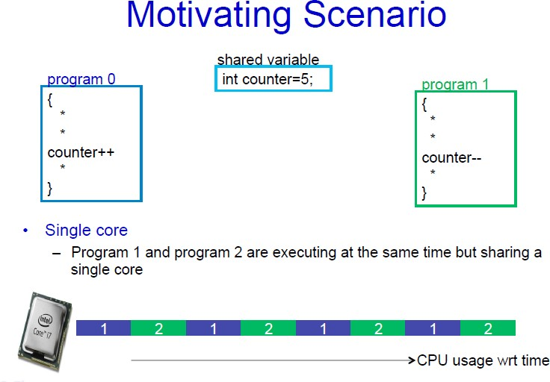

Slide 4
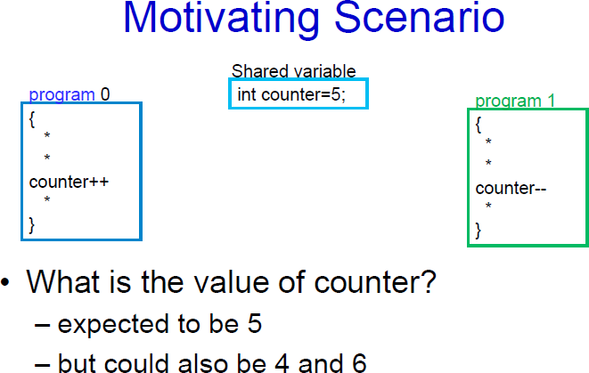

Slide 5
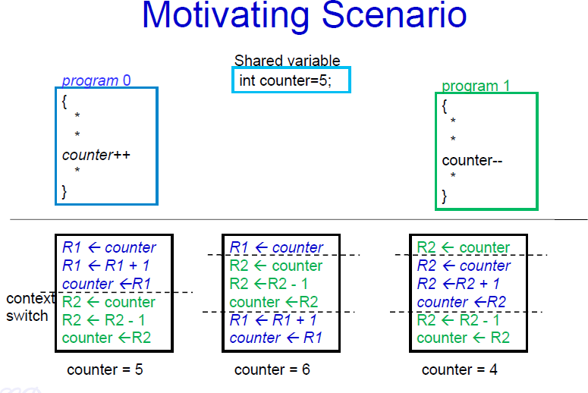

Slide 8
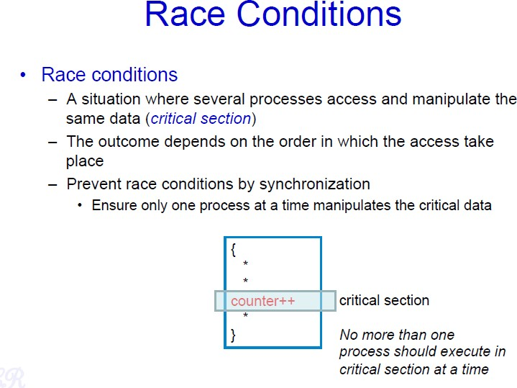

Slide 9
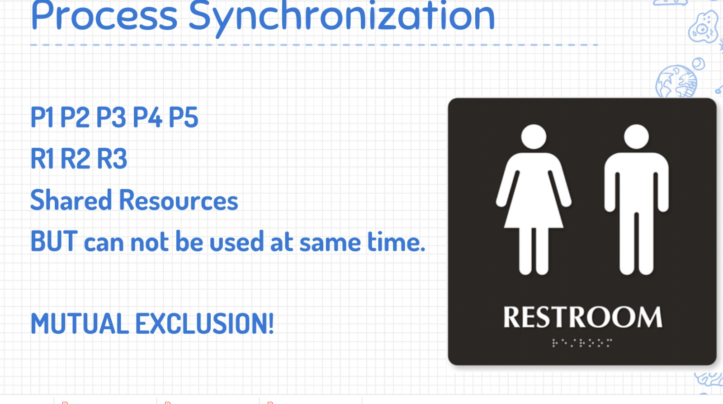

Slide 10
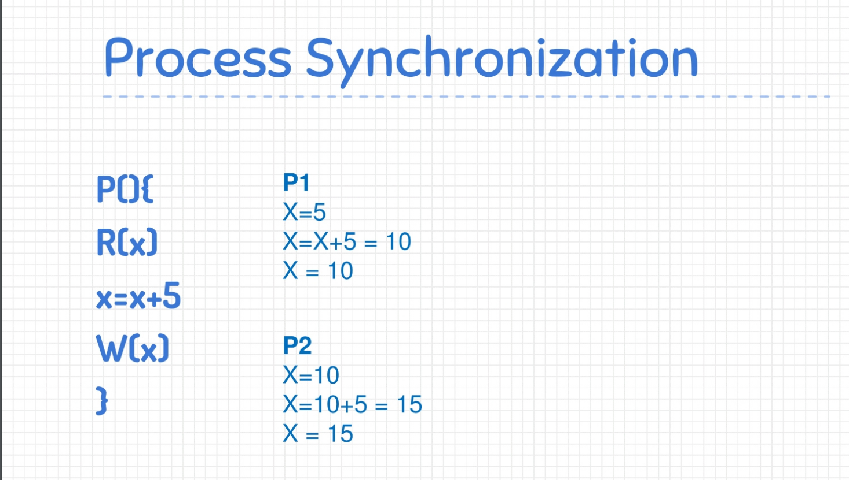

Slide 11
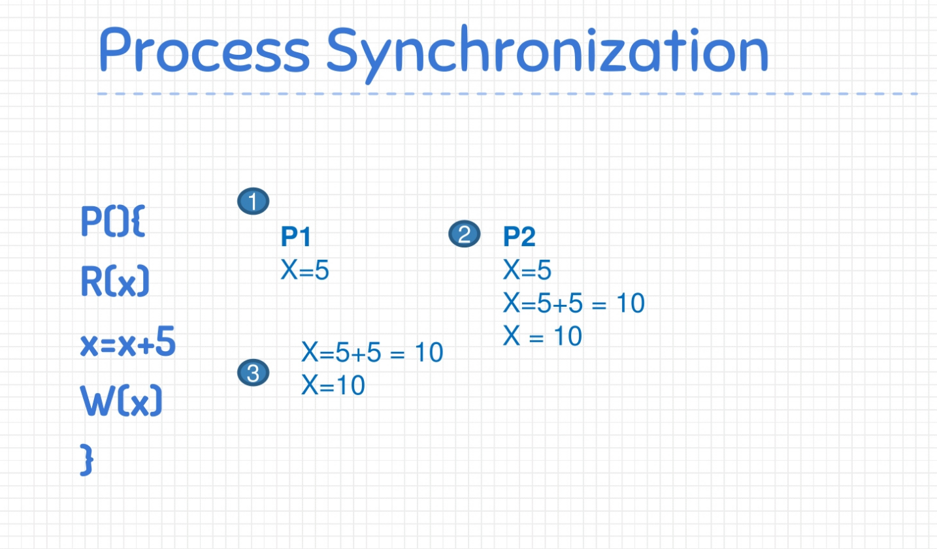

Slide 12
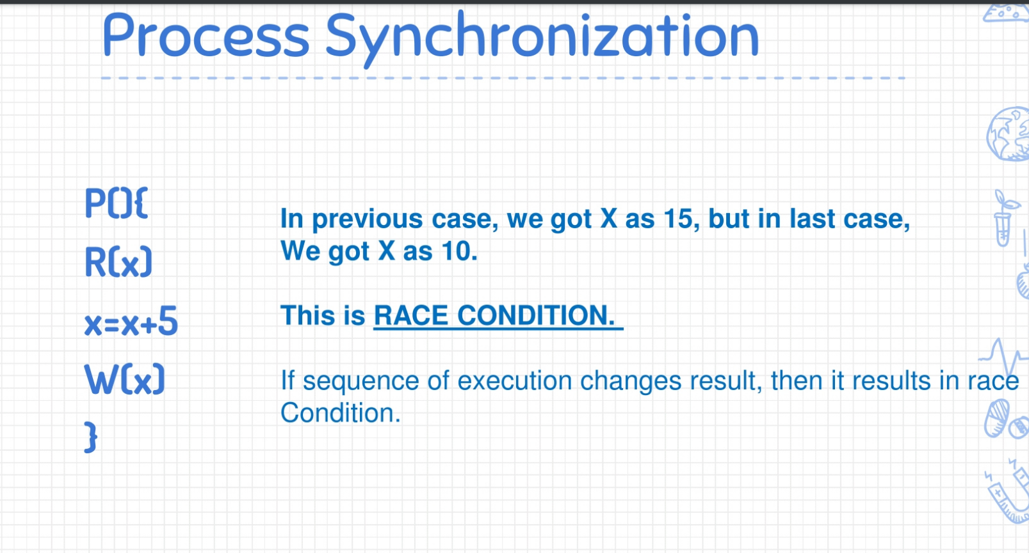

Slide 13
Critical Section Problem
Consider system of n processes {p₀, p₁, … p_{n-1}}
Each process has critical section segment of code
Process may be changing common variables, updating table, writing file, etc
When one process in critical section, no other may be in its critical
section
Critical section problem is to design protocol to solve this
Each process must ask permission to enter critical section in entry section, may follow critical section with exit section, then remainder section

Slide 14
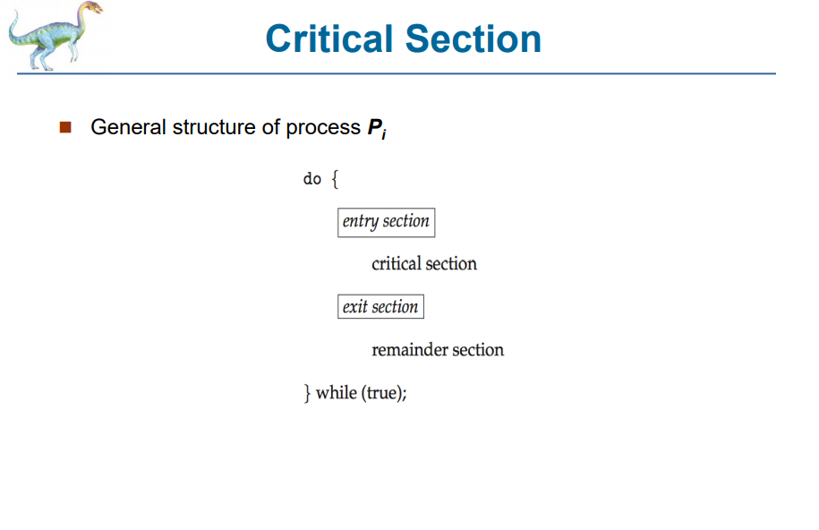

Slide 15
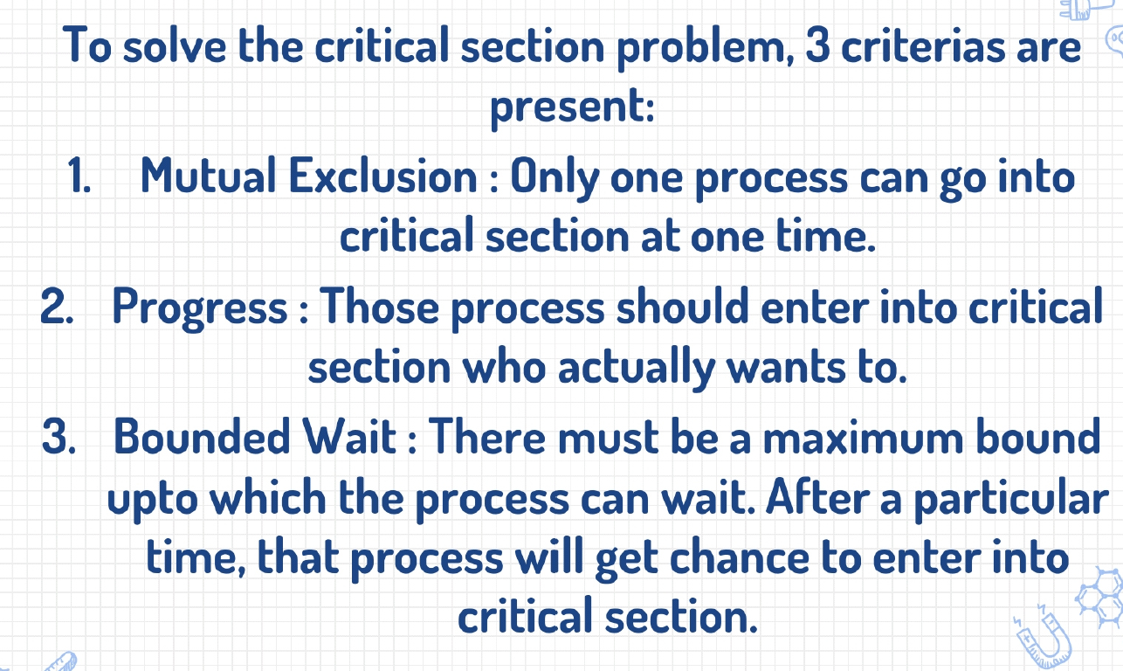
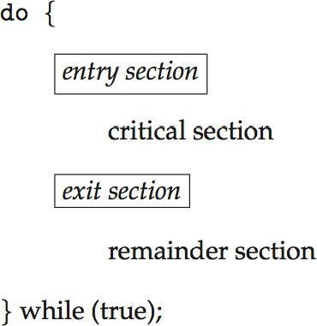
Critical Section
General structure of process P_{i}

Slide 16
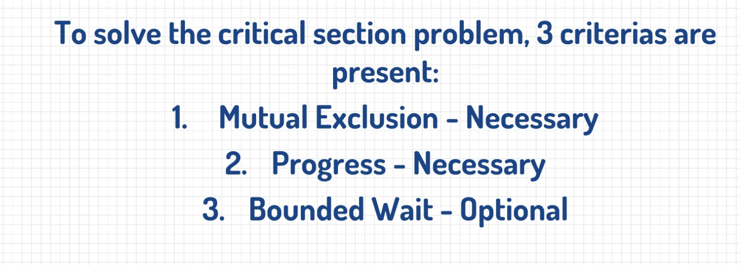

Slide 17
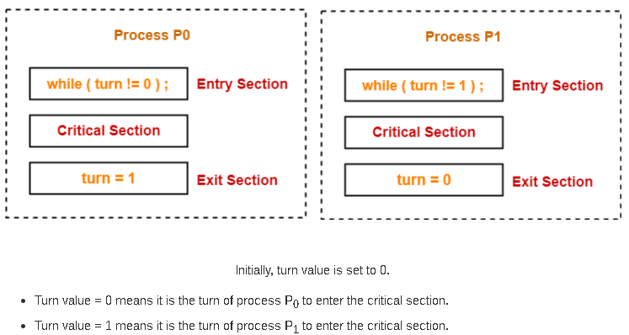
Algorithm 1

Slide 18
The characteristics of this synchronization mechanism are-
It ensures mutual exclusion.
It follows the strict alternation approach.
It does not guarantee progress since it follows strict alternation approach.
It ensures bounded waiting since processes are executed turn wise one by one and each process is guaranteed to get a chance.

Slide 19
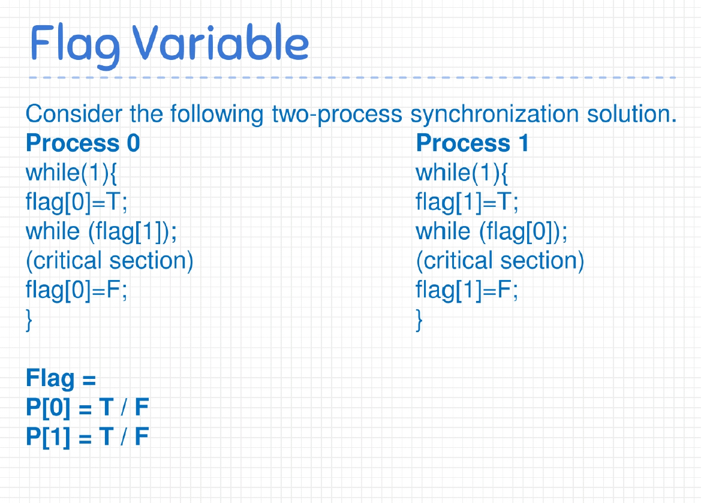

Slide 20
The characteristics of this synchronization mechanism are-
It ensures mutual exclusion.
It does not follow strict alternation approach.
It ensures progress since if a process is not interested to enter the critical section, it never stops the other process to enter the critical section.
It suffers from Deadlock.
Since it suffers from deadlock, it does not guarantee bounded waiting.

Slide 21
Peterson’s Solution
Good algorithmic description of solving the problem
Two process solution
Assume that the load and store machine-language instructions are atomic; that is, cannot be interrupted
The two processes share two variables:
int turn;
Boolean flag[2]
The variable turn indicates whose turn it is to enter the critical section
The flag array is used to indicate if a process is ready to enter the critical section. flag[i] = true implies that process P_{i} is ready!

Slide 22
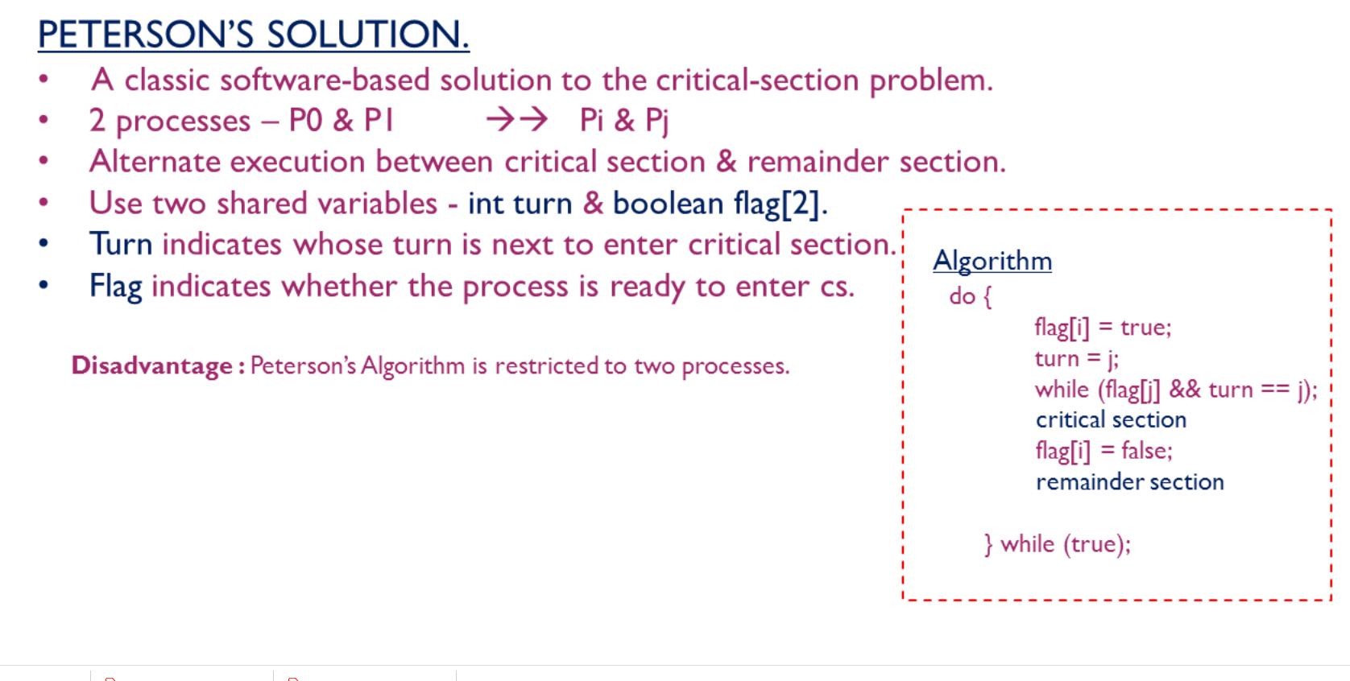

Slide 23
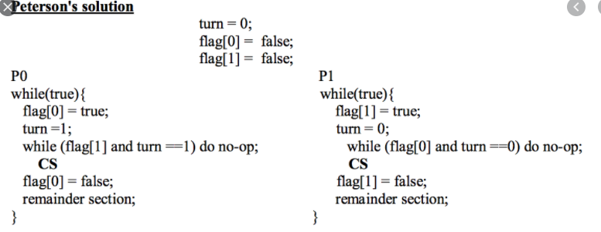

Slide 24
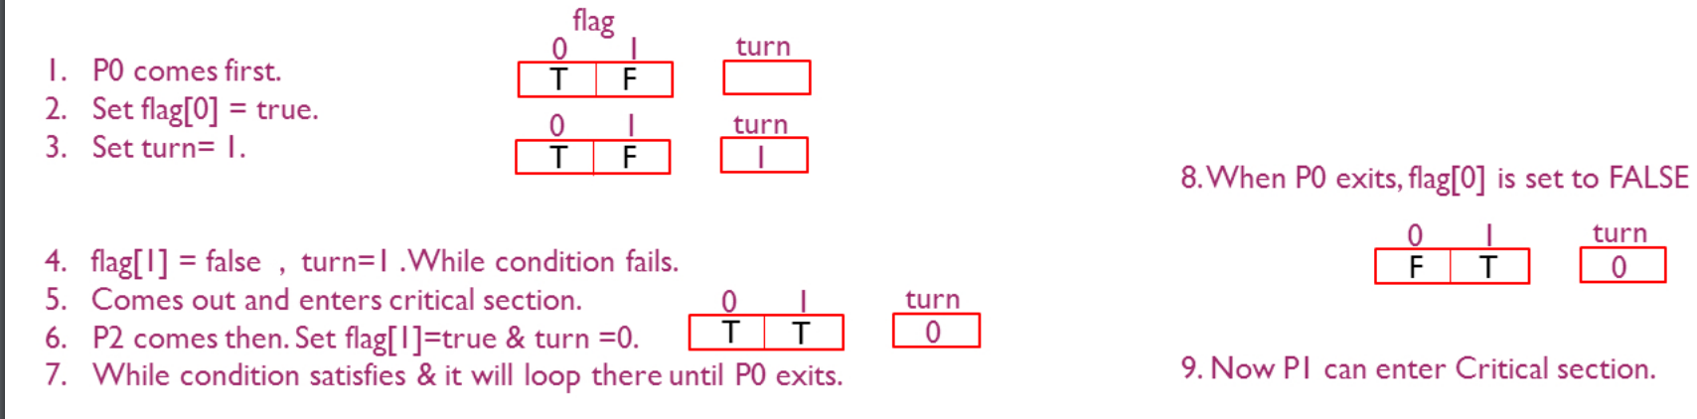

Slide 25
Peterson’s Solution preserves all three conditions :
Mutual Exclusion is assured as only one process can access the critical section at any time.
Progress is also assured, as a process outside the critical section does not block other processes from entering the critical section.
Bounded Waiting is preserved as every process gets a fair chance.
Disadvantages of Peterson’s Solution
It is limited to 2 processes.

Slide 26
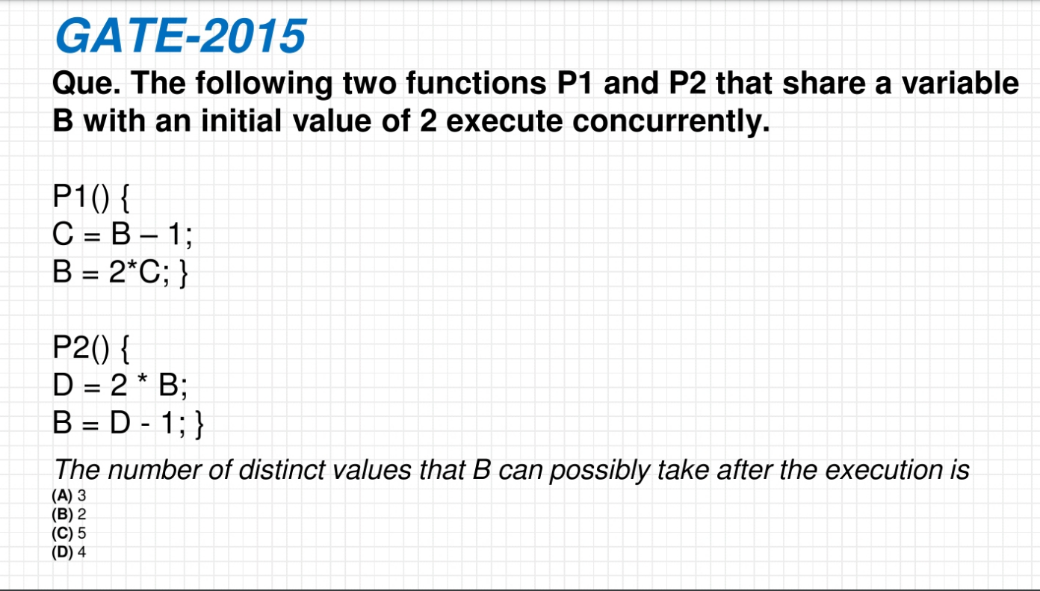

Slide 27
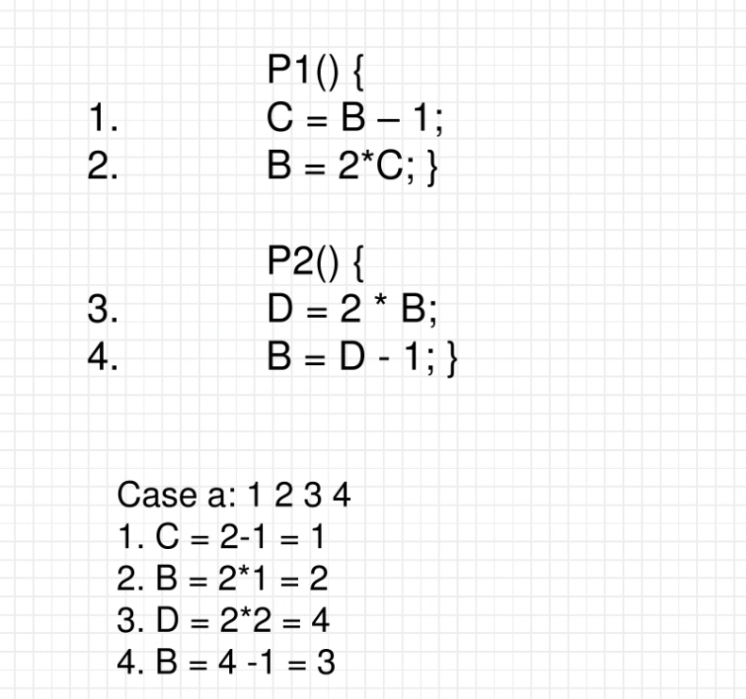

Slide 28
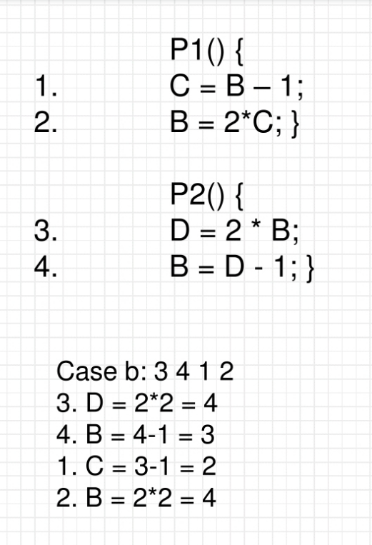

Slide 29
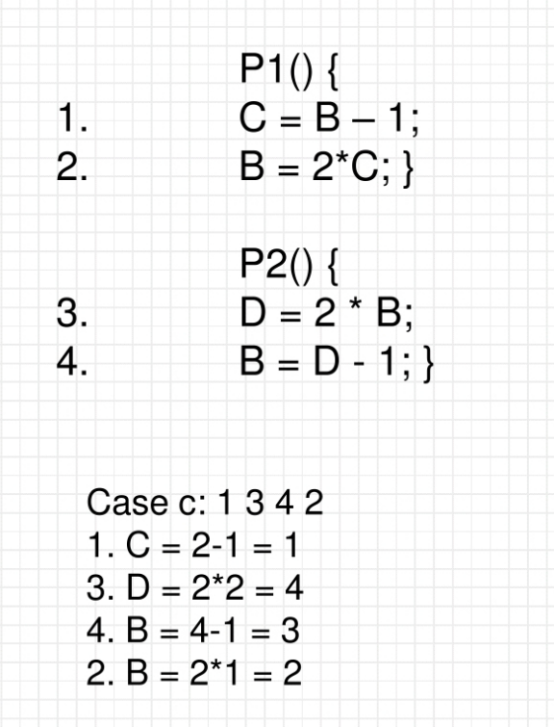

Slide 30
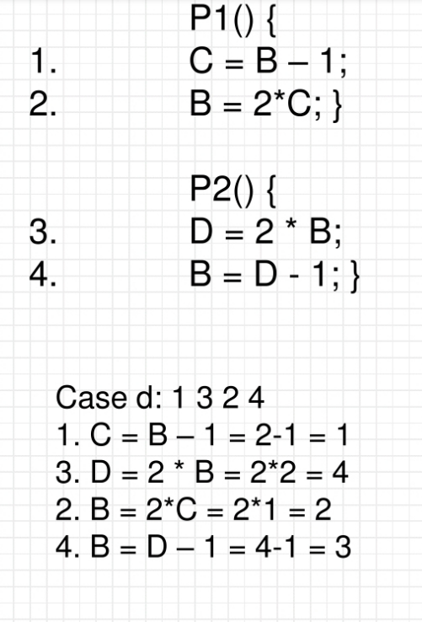

Slide 31
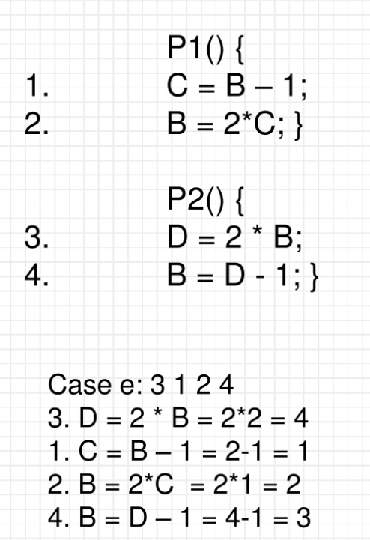

Slide 32
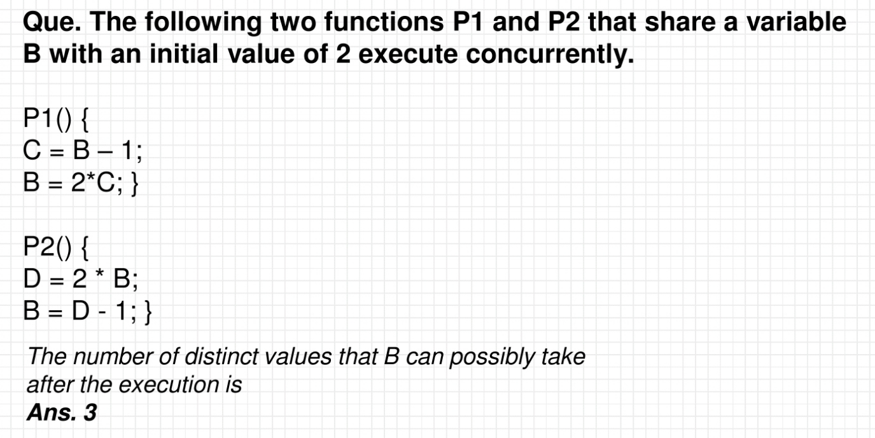

Slide 33
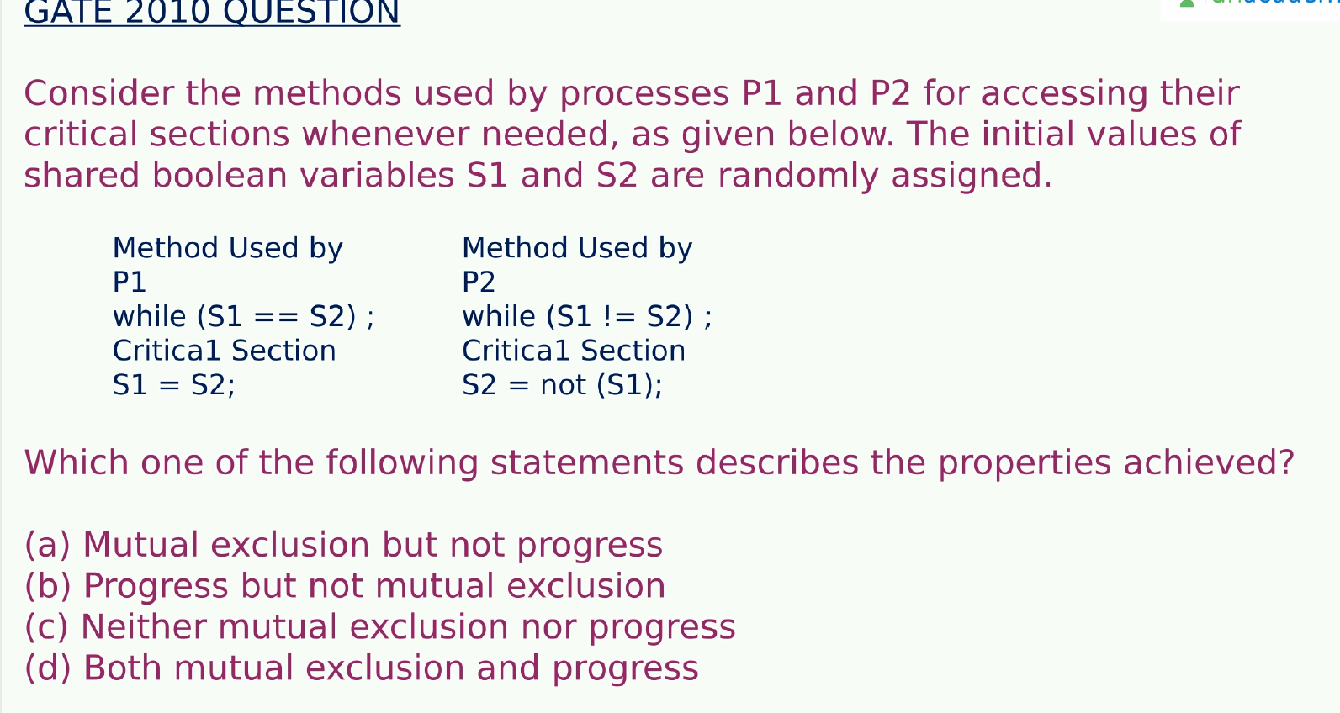

Slide 34
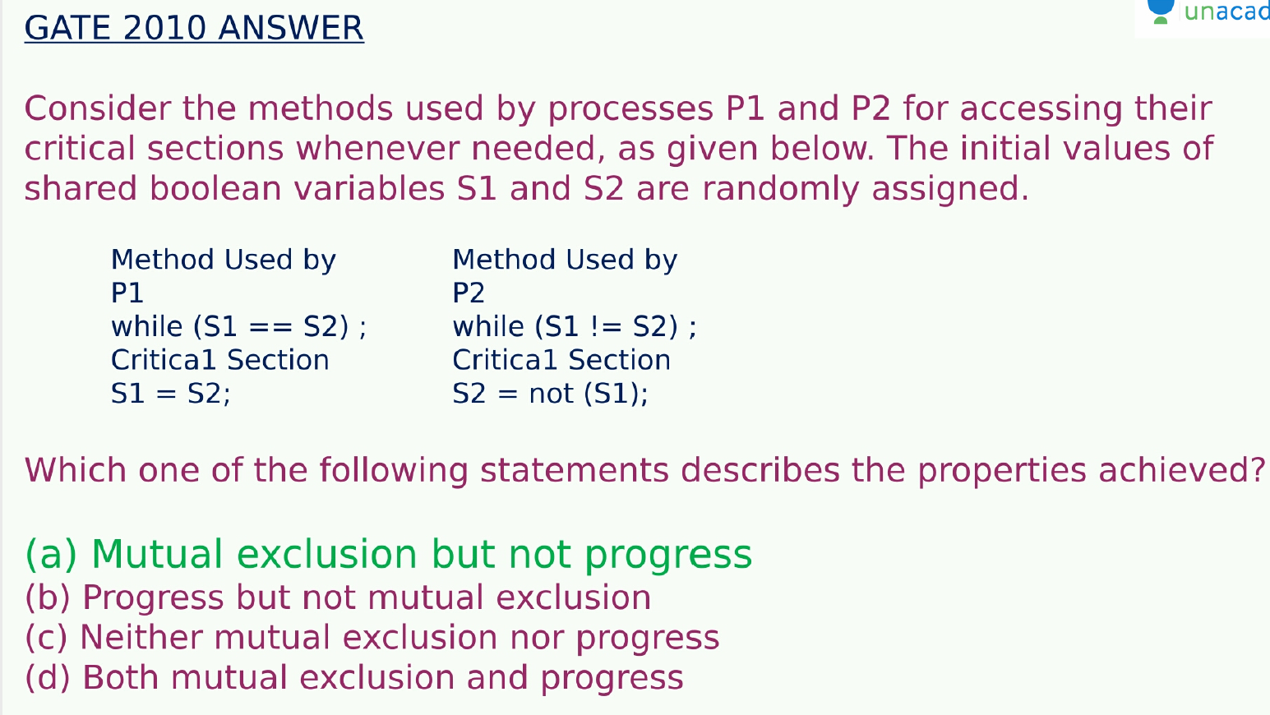

Slide 35
Semaphore
Synchronization tool that provides more sophisticated ways (than Mutex locks) for process to synchronize their activities.
Semaphore S – integer variable
Can only be accessed via two indivisible (atomic) operations
wait() and signal()
Originally called P() and V()
Definition of the wait() operation
wait(S) {
while (S <= 0)
; // busy wait
S--;
}
Definition of the signal() operation
signal(S) {
S++;
}

Slide 36
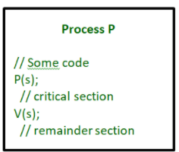

Slide 37
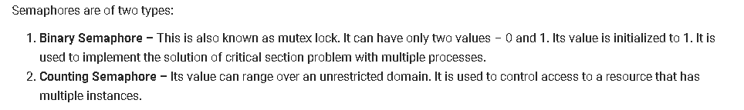

Slide 38
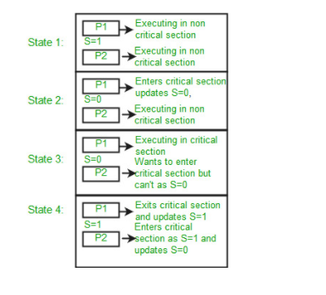

Slide 39
Semaphore Usage
Can solve various synchronization problems
Consider P₁ and P₂ that require S₁ to happen before S₂
Create a semaphore “synch” initialized to 0
P1:
S₁;
signal(synch);
P2:
wait(synch);
S₂;
Can implement a counting semaphore S as a binary semaphore

Slide 40
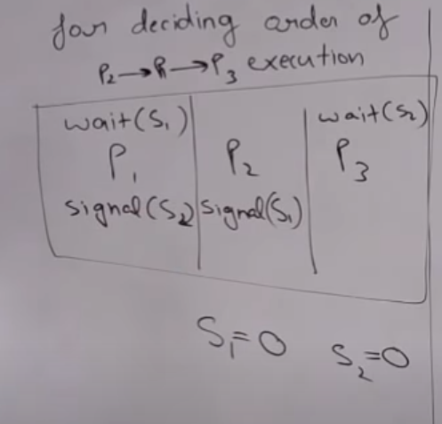

Slide 41
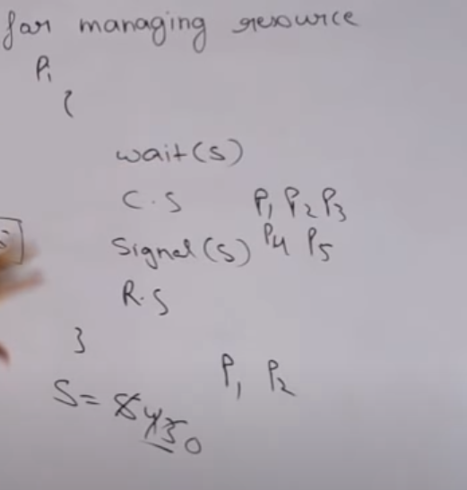

Slide 42
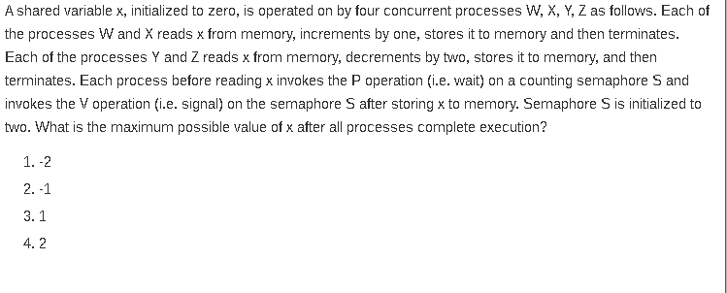

Slide 43
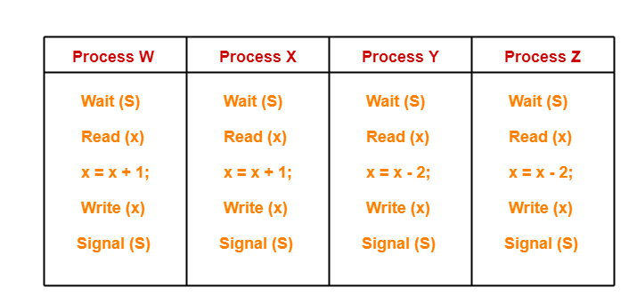
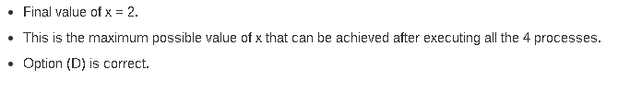

Slide 44
Semaphore Implementation
Must guarantee that no two processes can execute the wait() and signal() on the same semaphore at the same time
Thus, the implementation becomes the critical section problem where the wait and signal code are placed in the critical section
Could now have busy waiting in critical section implementation

Slide 45
Semaphore Implementation with no Busy waiting
With each semaphore there is an associated waiting queue
Each entry in a waiting queue has two data items:
value (of type integer)
pointer to next record in the list
Two operations:
block – place the process invoking the operation on the appropriate waiting queue
wakeup – remove one of processes in the waiting queue and place it in the ready queue
typedef struct{
int value;
struct process *list;
} semaphore;

Slide 46
Implementation with no Busy waiting (Cont.)
wait(semaphore *S) {
S->value--;
if (S->value < 0) { add this process to S->list;
block();
}
}
signal(semaphore *S) {
S->value++;
if (S->value <= 0) { remove a process P from S->list;
wakeup(P);
}
}

Slide 47
Deadlock and Starvation
Deadlock – two or more processes are waiting indefinitely for an event that can be caused by only one of the waiting processes
Let S and Q be two semaphores initialized to 1
P₀ P₁
wait(S); wait(Q);
wait(Q); wait(S);
... ...
signal(S); signal(Q);
signal(Q); signal(S);
Starvation – indefinite blocking
A process may never be removed from the semaphore queue in which it is suspended
Priority Inversion – Scheduling problem when lower-priority process holds a lock needed by higher-priority process
Solved via priority-inheritance protocol

Slide 48
Classical Problems of Synchronization
Classical problems used to test newly-proposed synchronization schemes
Bounded-Buffer Problem
Readers and Writers Problem
Dining-Philosophers Problem

Slide 49
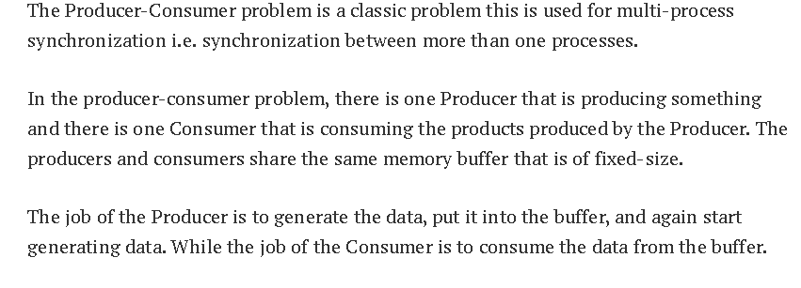
Bounded-Buffer Problem

Slide 50
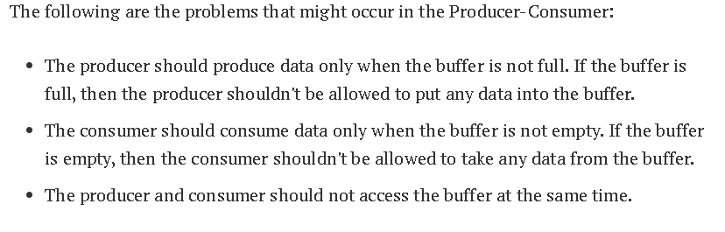
Bounded-Buffer Problem

Slide 51
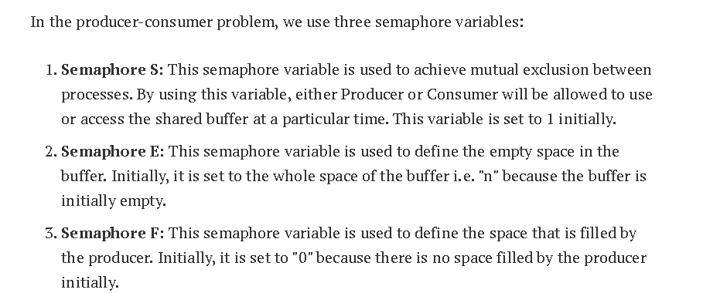

Slide 52
Bounded-Buffer Problem
n buffers, each can hold one item
Semaphore mutex initialized to the value 1
Semaphore full initialized to the value 0
Semaphore empty initialized to the value n

Slide 53
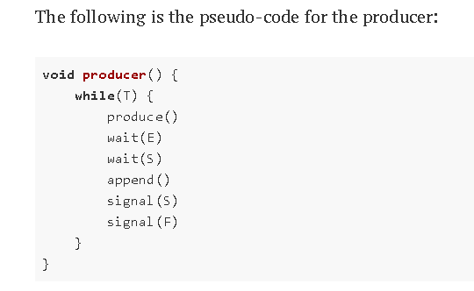

Slide 54
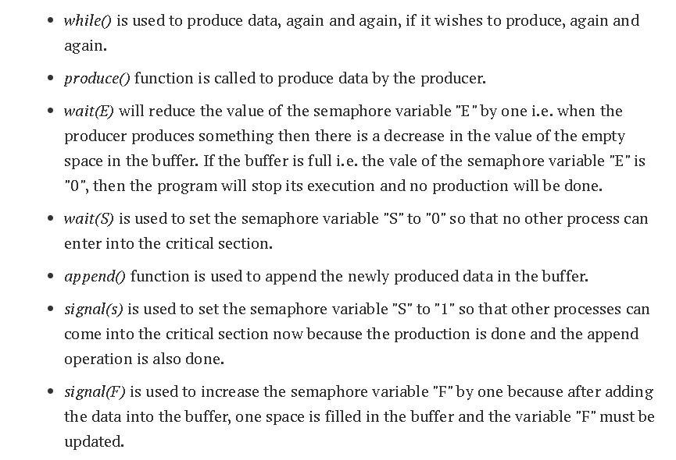

Slide 55
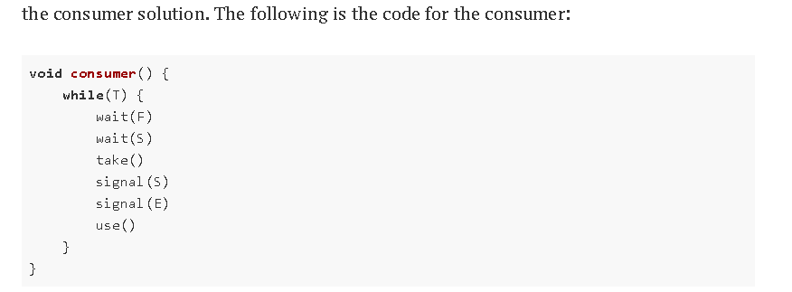

Slide 56
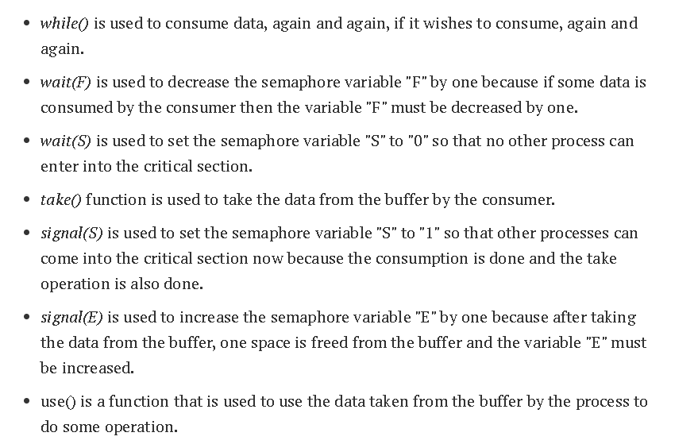

Slide 57
Bounded Buffer Problem (Cont.)
The structure of the producer process
do {
... /* produce an item in next_produced */
...
wait(empty);
wait(mutex);
... /* add next produced to the buffer */
...
signal(mutex);
signal(full);
} while (true);

Slide 58
Bounded Buffer Problem (Cont.)
The structure of the consumer process
Do {
wait(full);
wait(mutex);
... /* remove an item from buffer to next_consumed */
...
signal(mutex);
signal(empty);
... /* consume the item in next consumed */
... } while (true);

Slide 59
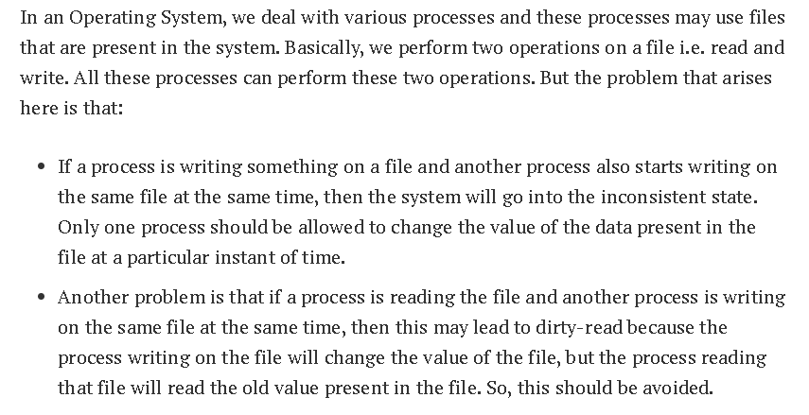
Readers-Writers Problem

Slide 60
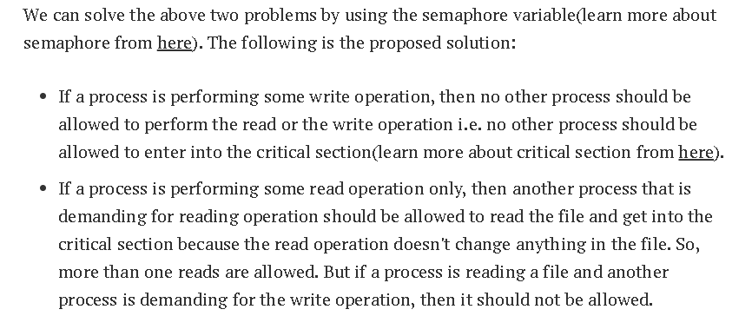

Slide 61
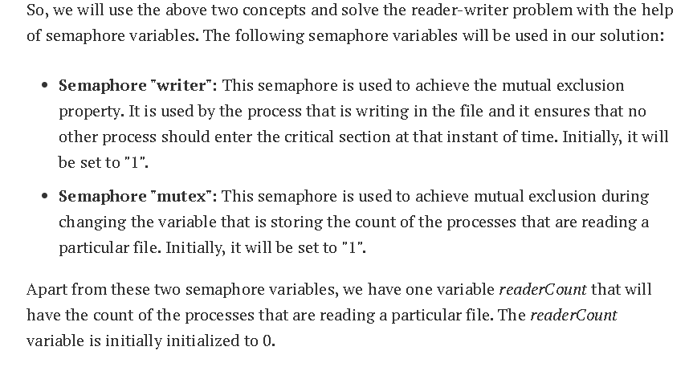

Slide 62
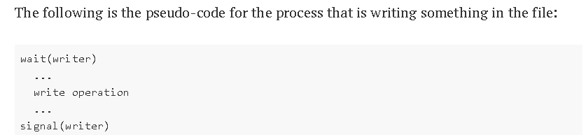

Slide 63
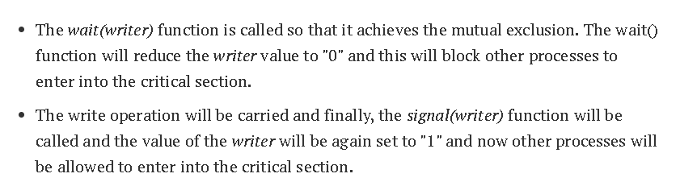

Slide 64
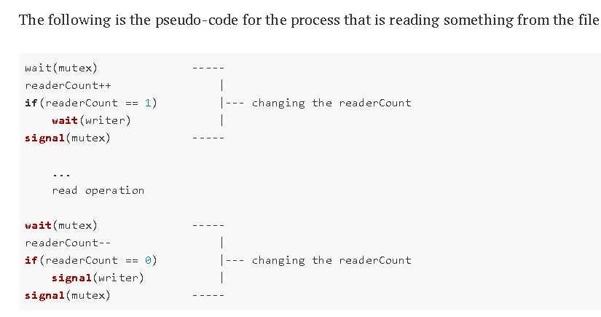

Slide 65
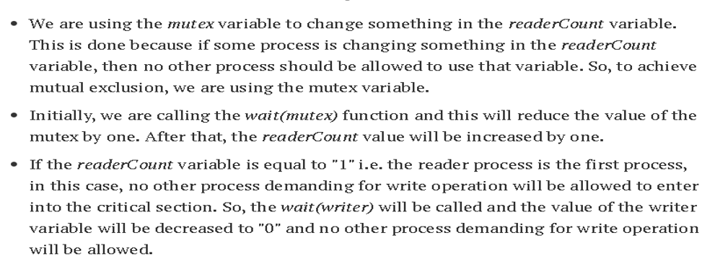

Slide 66
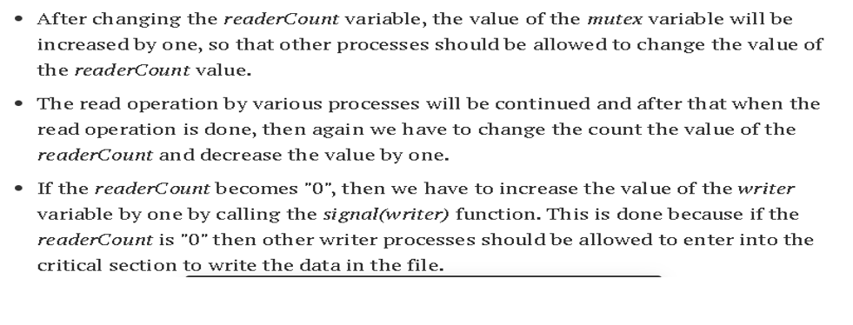

Slide 67
Readers-Writers Problem
A data set is shared among a number of concurrent processes
Readers – only read the data set; they do not perform any updates
Writers – can both read and write
Problem – allow multiple readers to read at the same time
Only one single writer can access the shared data at the same time
Several variations of how readers and writers are considered – all involve some form of priorities
Shared Data
Data set
Semaphore rw_mutex initialized to 1
Semaphore mutex initialized to 1
Integer read_count initialized to 0

Slide 68
Readers-Writers Problem (Cont.)
The structure of a writer process
do { wait(rw_mutex);
... /* writing is performed */
...
signal(rw_mutex);
} while (true);

Slide 69
Readers-Writers Problem (Cont.)
The structure of a reader process
do { wait(mutex); read_count++; if (read_count == 1)
wait(rw_mutex);
signal(mutex);
... /* reading is performed */
...
wait(mutex); read count--; if (read_count == 0)
signal(rw_mutex);
signal(mutex);
} while (true);

Slide 70
Readers-Writers Problem Variations
First variation – no reader kept waiting unless writer has permission to use shared object
Second variation – once writer is ready, it performs the write ASAP
Both may have starvation leading to even more variations
Problem is solved on some systems by kernel providing reader-writer locks

Slide 71
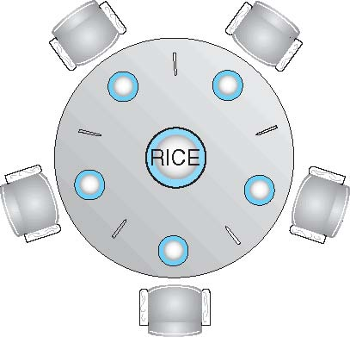
Dining-Philosophers Problem
Philosophers spend their lives alternating thinking and eating
Don’t interact with their neighbors, occasionally try to pick up 2 chopsticks (one at a time) to eat from bowl
Need both to eat, then release both when done
In the case of 5 philosophers
Shared data
Bowl of rice (data set)
Semaphore chopstick [5] initialized to 1

Slide 72
Dining-Philosophers Problem Algorithm
The structure of Philosopher i:
do {
wait (chopstick[i] );
wait (chopStick[ (i + 1) % 5] );
// eat
signal (chopstick[i] );
signal (chopstick[ (i + 1) % 5] );
// think
} while (TRUE);

Slide 73
What is the problem with this algorithm?
But if all five philosophers are hungry simultaneously, and each of them pickup one chopstick, then a deadlock situation occurs because they will be waiting for another chopstick forever.

Slide 74
Dining-Philosophers Problem Algorithm (Cont.)
Deadlock handling
Allow at most 4 philosophers to be sitting simultaneously at the table.
Allow a philosopher to pick up the forks only if both are available (picking must be done in a critical section.
Use an asymmetric solution -- an odd-numbered philosopher picks up first the left chopstick and then the right chopstick. Even-numbered philosopher picks up first the right chopstick and then the left chopstick.

